Slide 1
Diversity, Equity & Inclusion (DE&I) & Good Publication Practice:
Adapting to the Digital Era
Dikran Toroser, PhD CMPP
Merck & Co, Inc. Rahway, NJ, USA

Slide 2
DISCLAIMER
All opinions are the author’s and do NOT necessarily reflect the opinions of their present or past employers or any professional organization

Slide 3
3
AGENDA
GPP 2022: 4th iteration of GPP…it’s free to access
New content includes:
Diversity, Equity & Inclusion [DE&I], Plain Language Summaries [PLS-Ps] and Enhanced content [EC]
CHANGING TRENDS:
APAC, Demographics, Post-pandemic publication landscape
The DIGITAL ERA: ENTRY POINTS TO MEDICAL DATA and AI
Technology and Democratization of Medical Information
CONCLUSIONS and Future State

Slide 4
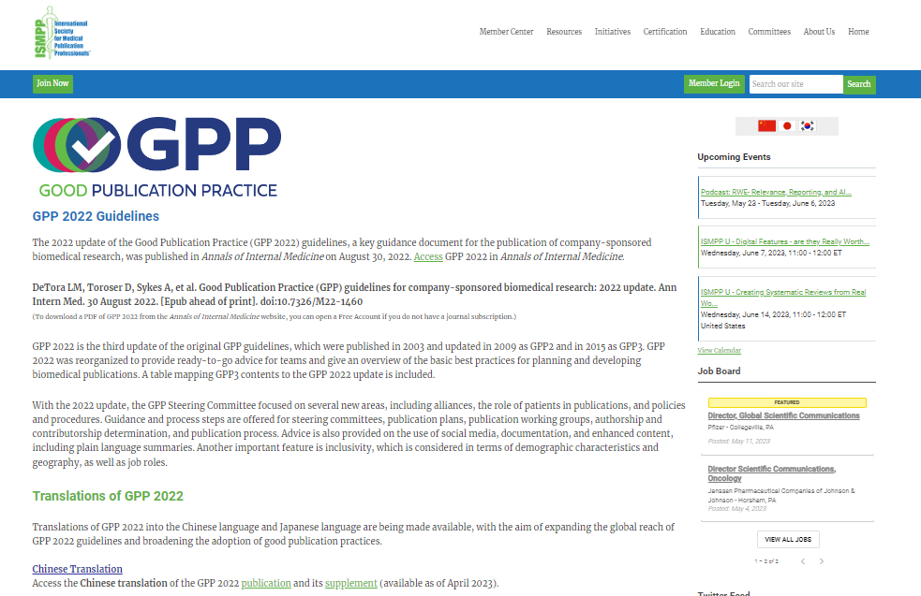
GPP 2022…what are the updates General description, and resources
Great summary from ISMPP pub planning workshop
5.5-pages in 2003→ 32-page guideline in GPP 2022
ISMPP WEB PORTAL
https://www.ismpp.org/gpp-2022
GPP 2022: https://www.acpjournals.org/doi/10.7326/M22-1460

Slide 5
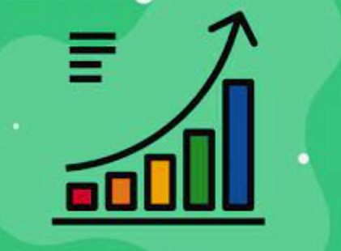
5
Volume & Speed…The Pubs Landscape
Staggering Growth in Publications and AUDIENCE
(Doubling of information every 9 years since WWII¹)
Largest growth: APAC/Emerging markets (India, China, South Korea)²
Unique, rapidly-evolving, hypercompetitive environment³
Staggering Diversity in APAC the region…socio-economic backgrounds, cultures and languages
Growing recognition of DE&I…especially in the workplace
COMPLEX and ongoing process
¹Bornmann and Mutz (2015) Growth rates of Modern Science
²AJE Scholarly Publishing Report (2016) Current Publication Trends
³Hesp, Arai, Bose et al., 2023 [CMRO] https://pubmed.ncbi.nlm.nih.gov/37184123/

Slide 6
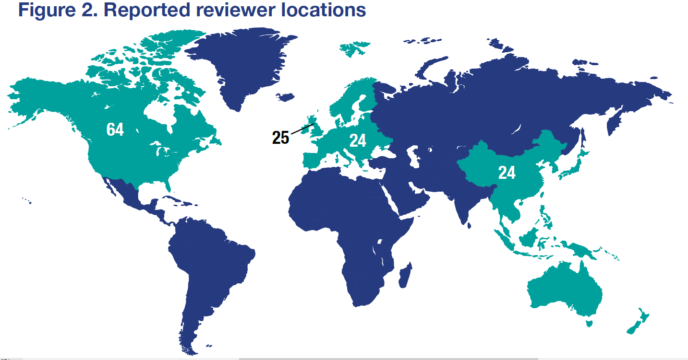
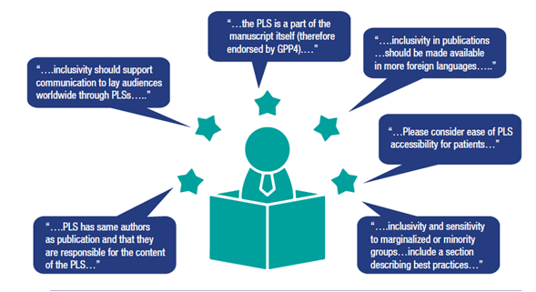
GPP 2022: Direct Quotes from Volunteer Reviewers
6
Reviewer locations*
Diversity, Equity & Inclusion
Plain Language Summaries
[Enhanced Content]

Slide 7
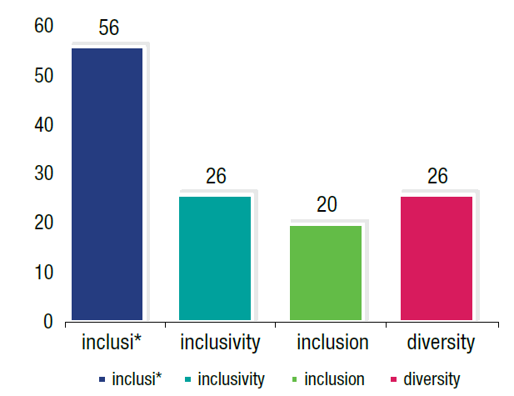
7
Volunteer Reviewer Feedback [GPP 2022]‡
DE&I
Incidence of keywords around DE&I in the raw comments
Diversity in trial design
FDA requirement…diversity plan for clinical trials
UREGS*
*Under Represented Ethnic Groups
‡“ISMPP Volunteer Reviewer Feedback on GPP 2022: Comments on Patients, Enhanced Content and PLS .”
Toroser, Dormer, DeTora, Hanekamp and Citrome. ISMPP 2023 Annual Meeting. Washington DC, USA

Slide 8
GPP 2022: Enhanced content and PLS
8
GPP endorses the use of enhanced content if it is developed following the same ethical and quality principles as the main publication
This includes the use of plain language summaries (PLS) to support the communication of scientific information to lay audiences
Formats might include text, video, audio, podcast, or infographic
Enhanced content must be consistent with that of the underlying publication and must not be promotional in language, tone, or style

Slide 9
…Increasing Volume & SPEED continued
9
1. New FORMATS for DIVERSE consumer populations
PLS-Ps, Enhanced Content, Preprints, Other
New formats often PubMed indexed [formal citations]
2. MULTIPLE ENTRY POINTS
Apps, Virtual sessions, Other
3. A paperless highly connected DIGITAL experience
Enhanced content
https://www.thelancet.com/the-lancet-voice

Slide 10
Challenges and Risks
10
SPEED: Concerns…retractions and bias
peer-review speed/quality
publication bias….(cherry picking?)
cost of OA publishing/inequality
AI: HUGELY powerful…could have unintended consequences
Potential challenge: use of generative AI inappropriately
Potential Inaccuracies
Potential Biases not yet defined, ethical framework not yet fully in place
AMWA-EMWA-ISMPP joint position statement on med pubs, preprints & peer review
https://www.tandfonline.com/doi/full/10.1080/03007995.2021.1900365
https://theacse.com/2021/slides/18.%20Dikran%20Toroser_.pptx

Slide 11
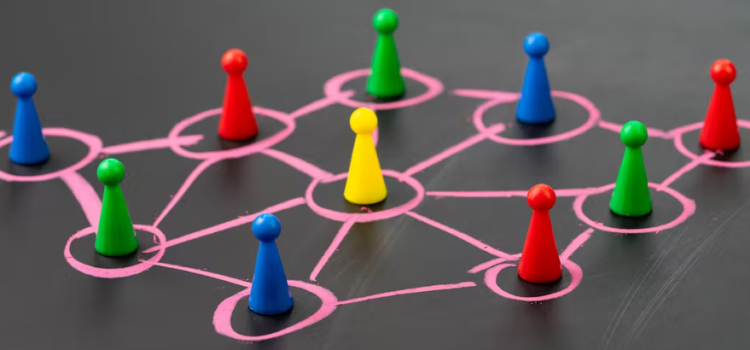
NEW NORMAL
11
11
RISK reduction for our “new normal”
GUIDELINES: (eg. GPP 2022 and EQUATOR network)
EDUCATION: ACSE, -workshops, professional organizations
DECENTRALIZATION and regions
REGIONAL Nuance…Cultural sensitivity
Increased Access to REGIONAL Healthcare information
DIGITAL ADAPTATION and AWARENESS is a MUST
Data generation
Ethical use and Definitions

Slide 12
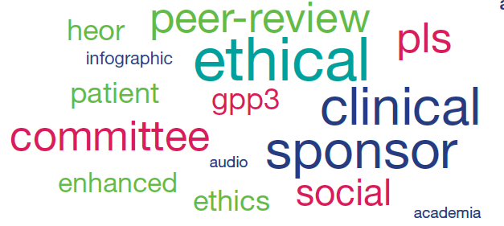
12
CONCLUSIONS and Future State
Increased ACCESS to publications
Publications incorporating DE&I concepts
Changing GLOBAL DEMOGRAPHIC of pubs consumers
SPEED to the public domain is increasing
AI use is here and will not go away…
Enhancements and efficiencies AI offers are real
Guidelines and Ethical frameworks will be needed
UNPRECEDENTED/exciting times in publications!

Slide 13
GPP 2022 Authoring Team
13
ACKNOWLEDGEMENTS
Dan Bridges
Lise Baltzer
Leslie Citrome
Lisa DeTora
Faith Di Biasi
Laura Dormer
Eline Hanekamp
Trevor Lane
Fiona Plunkett
Angela Sykes
Dikran Toroser
Christine Vanderlinden

Slide 14
14
QUESTIONS/Comments/Discussion

